Slide 1


AI-POWERED E-COMMERCE PLATFORM
Presented by -
Bharath Kumar K(22BCA0170)
Gokula Kannan S (22BCA0178)
Guided by -
Dr Priya V

Slide 2
Introduction
E-commerce platforms have transformed how people shop, offering convenience, variety, and accessibility. While platforms like Amazon, Flipkart, and Myntra dominate the industry, users often expect more personalization and advanced technology to simplify the shopping process. This project introduces an AI-driven e-commerce solution, leveraging cutting-edge technologies such as augmented reality, voice and visual search, and interactive data visualizations. By addressing user pain points like limited personalization, lack of immersive shopping options, and inventory mismanagement, the proposed system promises a seamless and innovative shopping experience.

Slide 3
Abstract
In the era of rapid technological advancements, e-commerce platforms play a vital role in global trade. This project aims to design and implement an AI-based e-commerce platform offering personalized product recommendations derived from user preferences, search history, and previous purchases. The platform will incorporate innovative features like voice and visual search mechanisms, purchase history visualization with interactive charts, and augmented reality (AR) for an immersive product experience. Furthermore, AI-driven inventory management ensures product availability, while an integrated chatbot assistant provides 24/7 customer support. These enhancements aim to provide a superior shopping experience and differentiate the platform from existing solutions in the competitive marketplace.

Slide 4
Problems
Problem 1
Lack of Personalized Shopping Experience
Existing e-commerce platforms struggle to provide precise product recommendations tailored to user preferences. Traditional recommendation engines rely on basic filters, often leading to irrelevant suggestions and decreased user engagement.
Problem 2
Inefficient Purchase History Insights
Users lack a comprehensive and interactive way to track and analyze their past purchases. Traditional purchase histories provide only static lists, making it hard for customers to make informed buying decisions.
Problem 3
Limited Search Capabilities
Most platforms rely on text-based search, making it difficult for users to find products when they don’t know the exact name. The absence of voice search and visual search mechanisms limits accessibility and convenience.

Slide 5
Problems
Problem 4
Poor Inventory Management
Manual and rule-based inventory management leads to stock shortages or overstocking, resulting in revenue loss and customer dissatisfaction. AI-driven inventory prediction is needed to optimize stock levels.
Problem 5
Absence of Augmented Reality (AR) Shopping
Customers face difficulty in visualizing how certain products, like clothing or accessories, will look in real life. The lack of AR integration limits user confidence in purchasing decisions.
Problem 6
Inadequate Customer Support
Conventional chatbot systems often provide scripted responses and fail to handle complex queries efficiently. Users require an AI-driven chatbot that provides real-time, intelligent, and context-aware assistance.

Slide 6


Solutions
AI-Powered Personalized Shopping Experience
Implement AI-based recommendation engines that analyze user behavior, purchase history, and browsing patterns.
Use machine learning models to suggest products tailored to user preferences dynamically.
Improve engagement with real-time recommendation updates.
Interactive Purchase History and Insights
Develop a visual analytics dashboard displaying past purchases using interactive charts and graphs.
Provide AI-driven spending insights, trends, and personalized discounts based on purchase behavior.
Suggest repurchases or complementary products based on user purchase history.

Slide 7
Solutions
Advanced Search Capabilities (Voice & Visual Search)
Integrate Voice Search using Natural Language Processing (NLP) to allow users to search products by speaking.
Implement Visual Search using AI-based image recognition (e.g., TensorFlow, OpenCV) to enable users to search products by uploading images.
Provide multi-modal search options (combining text, voice, and images) for a seamless experience.
AI-Driven Inventory Management
Utilize AI algorithms to predict demand and manage inventory levels efficiently.
Implement automated stock alerts to prevent shortages and excess stock accumulation.
Use Predictive analytics to optimize supply chain and stock distribution.

Slide 8
Solutions
Augmented reality (AR) Shopping
Integrate Web AR technology to allow users to try on clothes, accessories, or furniture before purchasing.
Use AR overlays to help customers visualize Products in real-world environments.
Provide interactive 3D models for a more immersive shopping experience.
AI-Powered chatbot & Customer Support
Implement an AI chatbot with Natural Language Understanding (NLU) to provide instant and accurate responses to customer queries.
Enable chatbot-based order tracking, product recommendations, and issue resolution.
Utilize sentiment analysis to improve chatbot interactions and customer satisfaction.

Slide 9
Objectives
Develop an AI-driven recommendation system to enhance product personalization.
Integrate advanced search mechanisms, including voice and visual search.
Implement augmented reality for selected products to offer immersive shopping experiences.
Design interactive charts for purchase history visualization, aiding better user insights.
Ensure efficient inventory management through AI techniques for real-time stock updates.
Provide a responsive chatbot for seamless customer interaction and support.

Slide 10
Scope
This platform caters to both customers and administrators, offering innovative features aimed at:
Customers: Enhancing user experience through personalized recommendations, advanced search, AR product viewing, and intuitive visualizations of purchase history.
Administrators: Streamlining inventory management and gaining insights through AI-driven tools.
With a focus on scalability and modularity, the system can be expanded to include additional products, categories, and features as needed

Slide 11

AI-Powered Recommendations – Personalized product suggestions based on user behavior.
01
Visual Search & Visual Search -
Search Products using voice commands and also by uploading images.
02
FEATURES
AI Inventory Management and chatbot support-
Smart stock prediction and optimization and 24/7 intelligent customer assistance..
03
04
Secure Unique User code Login and multi-device access-
Access accounts using a unique code and log in from any device effortlessly.

Slide 12
05
Multi-Language Support -
AI based translations for global reach.
FEATURES
06
Dynamic UI customization -
Personalized shopping interface

Slide 13
Proposed System
1. Personalized Recommendation Engine: AI algorithms analyze user preferences,
search patterns, and purchase history to suggest relevant products, increasing
engagement and conversions.
2. Voice and Visual Search: Users can search for products by speaking or uploading
images. AI processes the input and matches it with the best-suited items.
3. Augmented Reality Integration: Select products, such as furniture and apparel, will
feature AR capabilities, allowing users to visualize items in real-world settings before
purchasing.
4. Purchase History Visualization: Interactive charts displaying purchase trends,
spending patterns, and preferred categories enable users to understand their shopping
behavior.

Slide 14
Proposed System
5. AI-Powered Inventory Management: AI tracks sales trends and stock levels to
prevent overstocking or stockouts, ensuring efficient resource utilization.
6. Chatbot Assistant: A conversational AI tool assists users with queries, order tracking,
and issue resolution, enhancing customer support.

Slide 15









Tech Stack
FRONT END
BACK END
NodeJS
Express

Slide 16







Tech Stack
DATABASE
API
MongoDB
Mongoose
JWT
Stripe
Twilio

Slide 17
Existing Platform Status
Projected Growth After Implementation

Slide 18
🌍Profitable & Beneficial Aspects
✔ Increased Sales: AI-powered recommendations boost purchases. ✔ Better User Experience: Voice & visual search make shopping easier. ✔ Higher Retention: Engaging features keep users coming back. ✔ Efficiency in Inventory: AI manages stock smartly, reducing waste. ✔ Inclusive Shopping: AR helps users visualize products before buying.

Slide 19
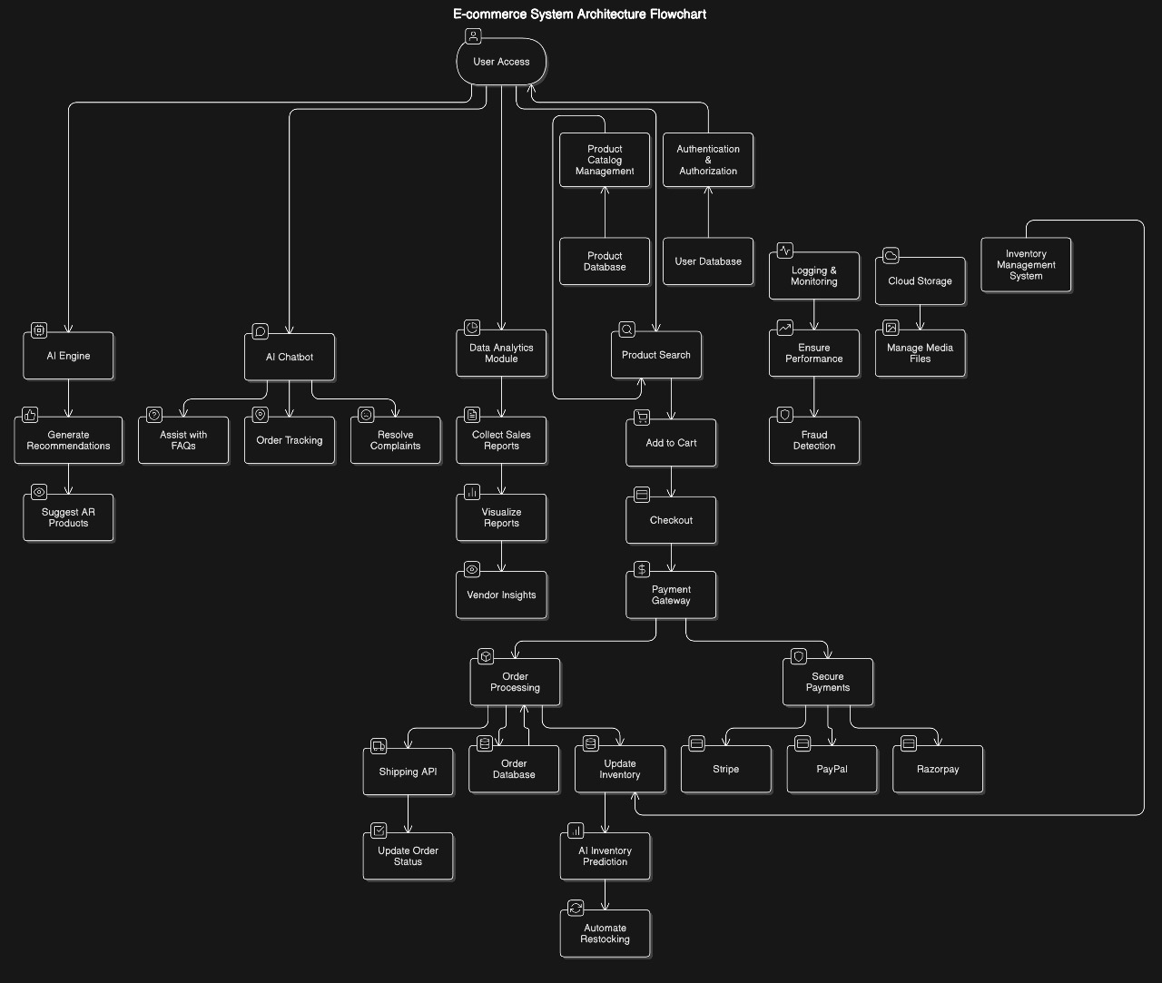

Slide 20
Conclusion
This AI-based e-commerce platform enhances user experience through personalized recommendations, voice and visual search, and AI-powered inventory management. It improves engagement, boosts sales, and simplifies shopping with features like AR and chatbots. By leveraging AI, the platform ensures efficiency, accuracy, and customer satisfaction. Overall, it creates a smarter and more convenient online marketplace for users worldwide.

Slide 21
Thank you

